Slide 1



Methods
What is a method
Java OOP
Basics
SoftUni Team
Technical Trainers
Software University
http://softuni.bg

Slide 2

Table of Contents
What is a method?
Method return types
Method parameters
Overloading

Slide 3
Questions
sli.do #2831

Slide 4

What is a Method?

Slide 5
Simple Methods
Method named printHeader
void printHeader() { System.out.println("----------"); }

Slide 6

Method Return Types
Return Value

Slide 7
Simple Void Method Example
void printLetterM() { System.out.println("|\\ /|"); System.out.println("| \\ / |"); System.out.println("| \\ / |"); System.out.println("| \\ / |"); }

Slide 8
Method Return Types
Method returns a result of type int
int sumNumbers(int a, int b) { return a + b; }
Returns a value as a result of the method call
sumNumbers(5,6); // 11 sumNumbers(5,5); // 10

Slide 9

Methods
Live Exercises in Class (Lab)

Slide 10
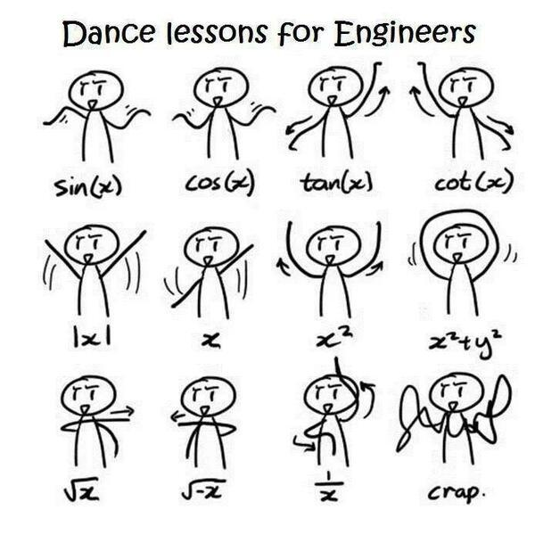
Method Parameters

Slide 11
Method Parameters
String concatenate( String head, String body, String tail) { return head + body + tail; }
Parameters

Slide 12
Method Arguments
Arguments
concatenate("Pesho", "is", "a student");
// Pesho is a student

Slide 13

Method Signature

Slide 14
Method Signature
Method's signature
public static void main(String[] args) throws Exception { System.out.println("Hello Java!"); }

Slide 15

Varargs

Slide 16
Varargs: Before
String iterate(String[] varargs){ // Iterates trough the varargs }

Slide 17
Varargs: After
Varargs keyword
String iterate(String... varargs){ // Iterates trough the varargs }

Slide 18
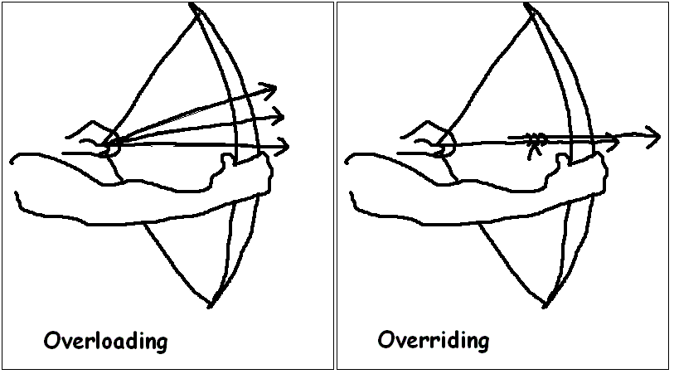
Overloading

Slide 19
Overloading Example
void print(String text) { // Print text } void print(String text, Date date) { // Print text + date }

Slide 20

Summary
Methods are named pieces of code that can be invoked later (with parameters)
Methods could return value or they could
return void
Methods could have same name but
they must have different signature

Slide 21








Methods
https://softuni.bg/java-basics-oop

Slide 22
License
This course (slides, examples, demos, videos, homework, etc.) is licensed under the "Creative Commons Attribution-NonCommercial-ShareAlike 4.0 International" license
Attribution: this work may contain portions from
"Fundamentals of Computer Programming with Java" book by Svetlin Nakov & Co. under CC-BY-SA license

Slide 23






Free Trainings @ Software University
Software University Foundation – softuni.org
Software University – High-Quality Education, Profession and Job for Software Developers
softuni.bg
Software University @ Facebook
facebook.com/SoftwareUniversity
Software University @ YouTube
youtube.com/SoftwareUniversity
Software University Forums – forum.softuni.bg

